Slide 1
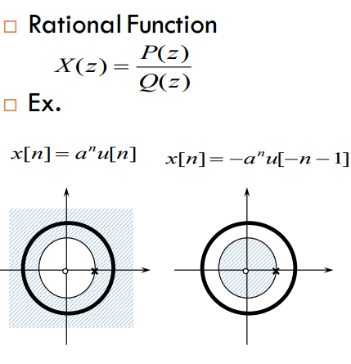

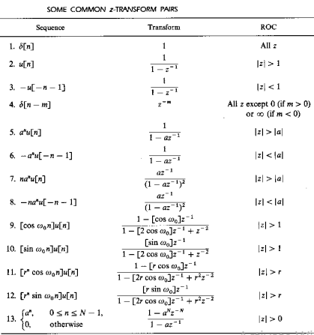

$Z−$ Transform

Slide 2
Book: Advanced Modern Engineering Mathematics (4th Edition) by Glyn
James
Chapter: 6
Sections: 6.2, 6.3

Slide 26
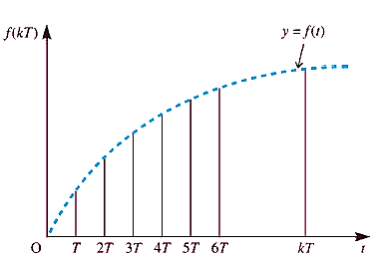
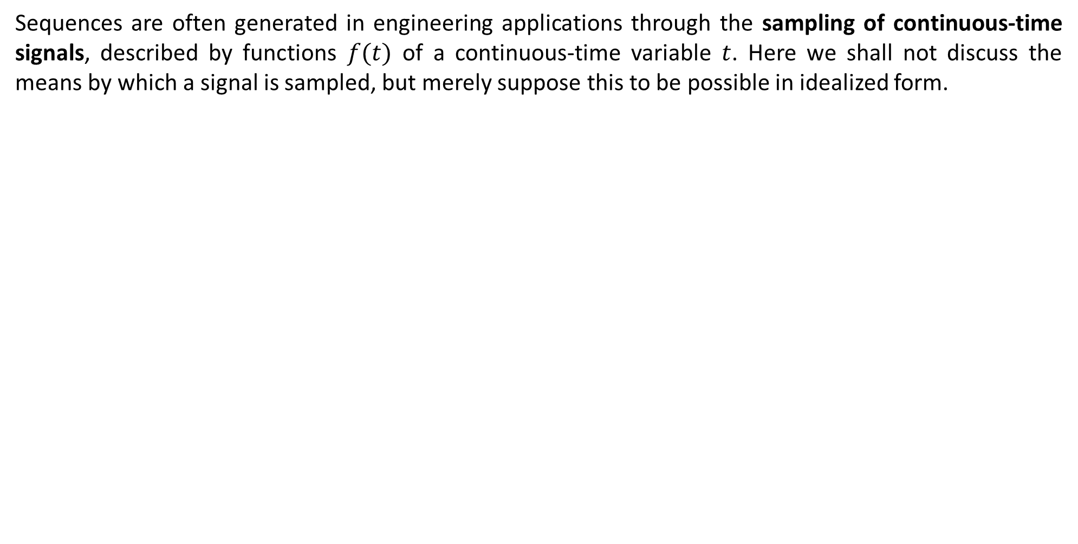
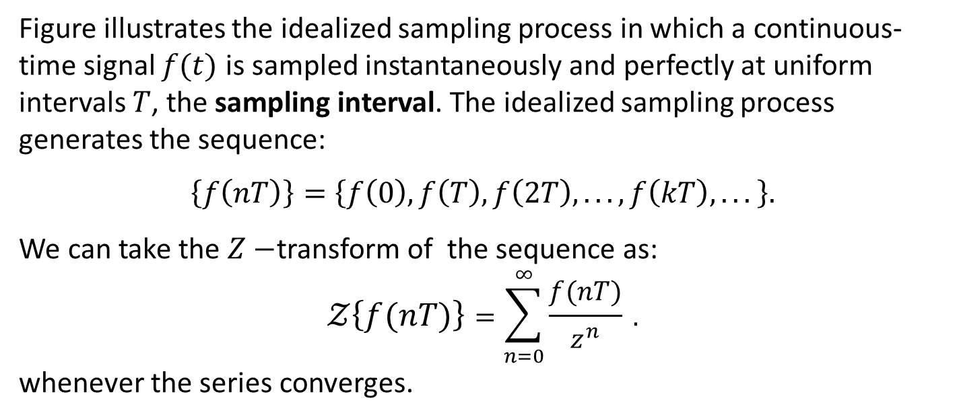
Sampling:
Sequences are often generated in engineering applications through the sampling of continuous-time signals, described by functions $f(t)$ of a continuous-time variable $t$. Here we shall not discuss the means by which a signal is sampled, but merely suppose this to be possible in idealized form.
Figure illustrates the idealized sampling process in which a continuous-time signal $f(t)$ is sampled instantaneously and perfectly at uniform intervals $T$, the sampling interval. The idealized sampling process generates the sequence:
$\left\{f\left(nT\right)\right\}=\left\{f\left(0\right), f\left(T\right), f\left(2T\right), . . . , f\left(kT\right), . . . \right\}.$
We can take the $Z−$transform of the sequence as:
$$𝒵\left\{f(nT)\right\}=\sum_{n=0}^{∞}{\frac{f(nT)}{z^{n}} }.$$
whenever the series converges.
Sampling of a continuous-time signal.

Slide 27
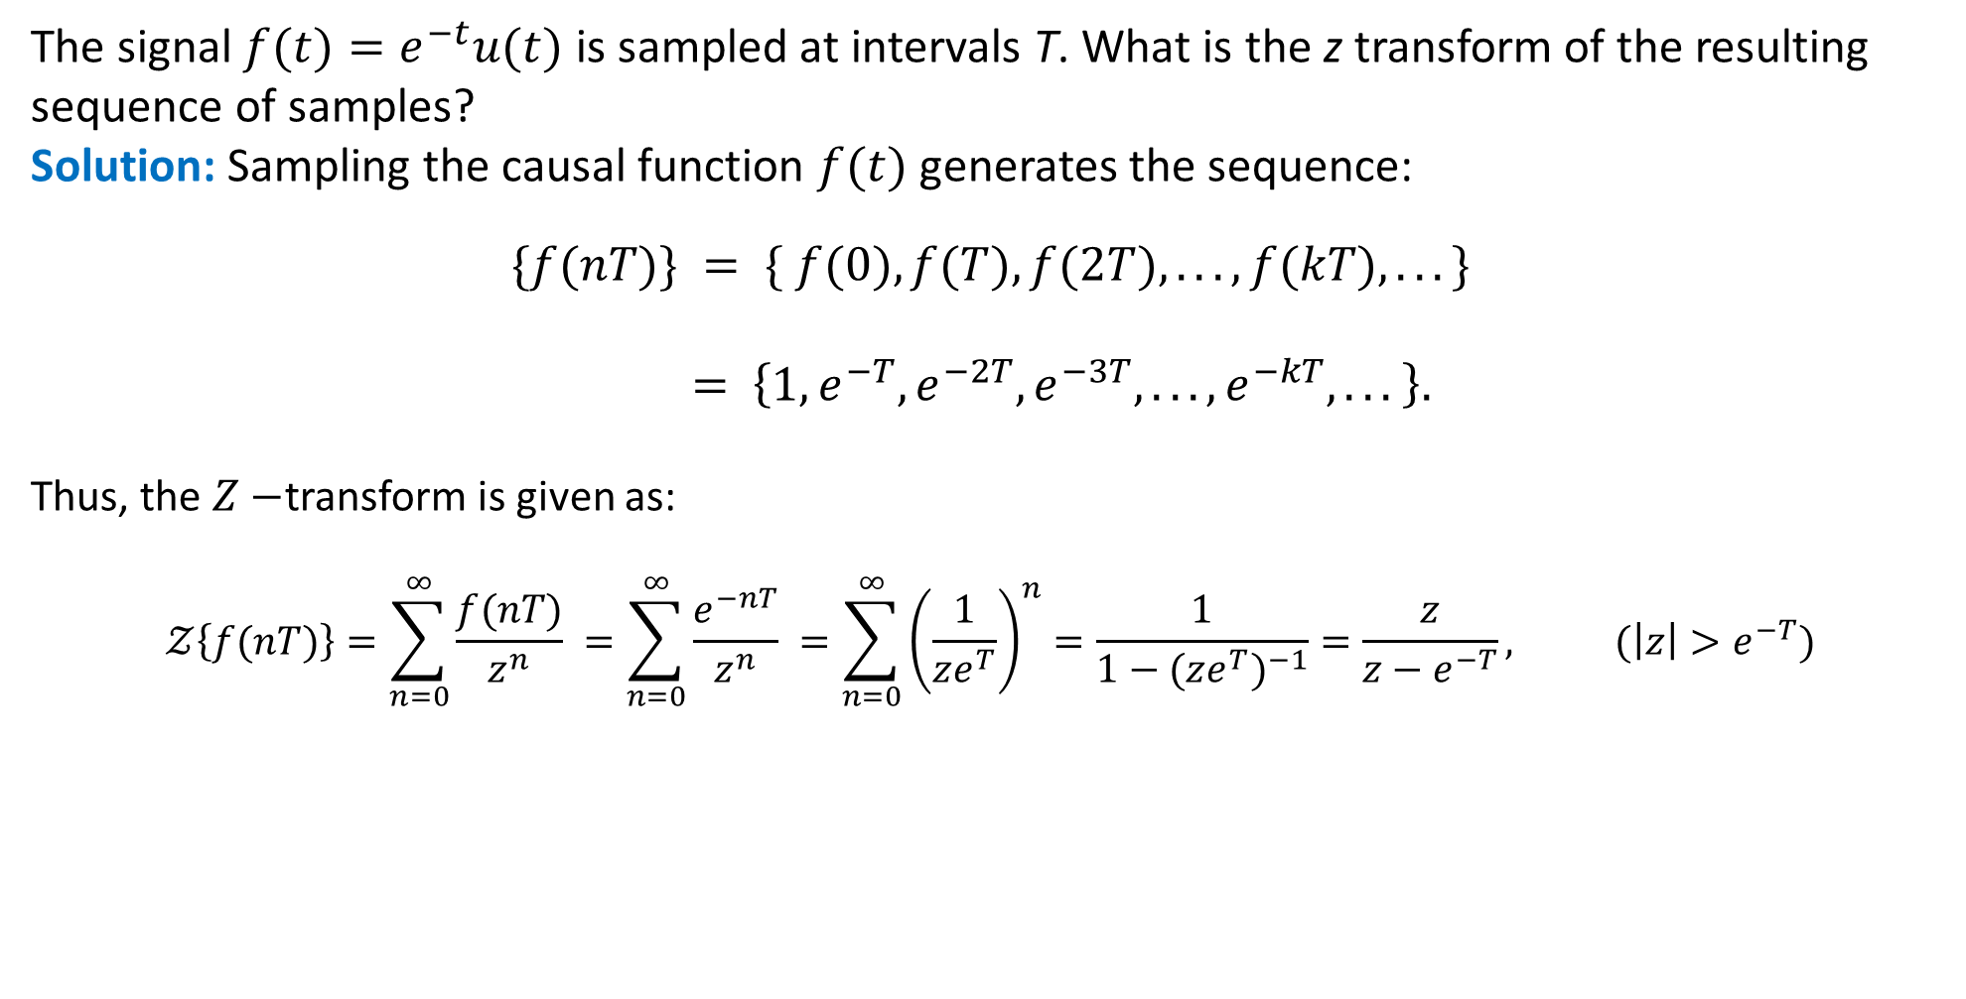
Example:
The signal $f(t)=e^{−t}u(t)$ is sampled at intervals T. What is the z transform of the resulting
sequence of samples?
Solution: Sampling the causal function $f(t)$ generates the sequence:
$$\{f(nT)\} = \{ f(0), f(T), f(2T), . . . , f(kT), . . . \}$$
$= \left\{1,e^{−T},e^{−2T},e^{−3T}, . . . ,e^{−kT}, . . . \right\}.$
Thus, the $Z−$transform is given as:
$$𝒵\left\{f(nT)\right\}=\sum_{n=0}^{∞}{\frac{f(nT)}{z^{n}} }=\sum_{n=0}^{∞}{\frac{e^{−nT}}{z^{n}} }=\sum_{n=0}^{∞}{{\left(\frac{1}{ze^{T}}\right)}^{n}}=\frac{1}{1−{(ze^{T})}^{−1}}=\frac{z}{z−e^{−T}}, (\left|z\right|>e^{−T})$$

Slide 29
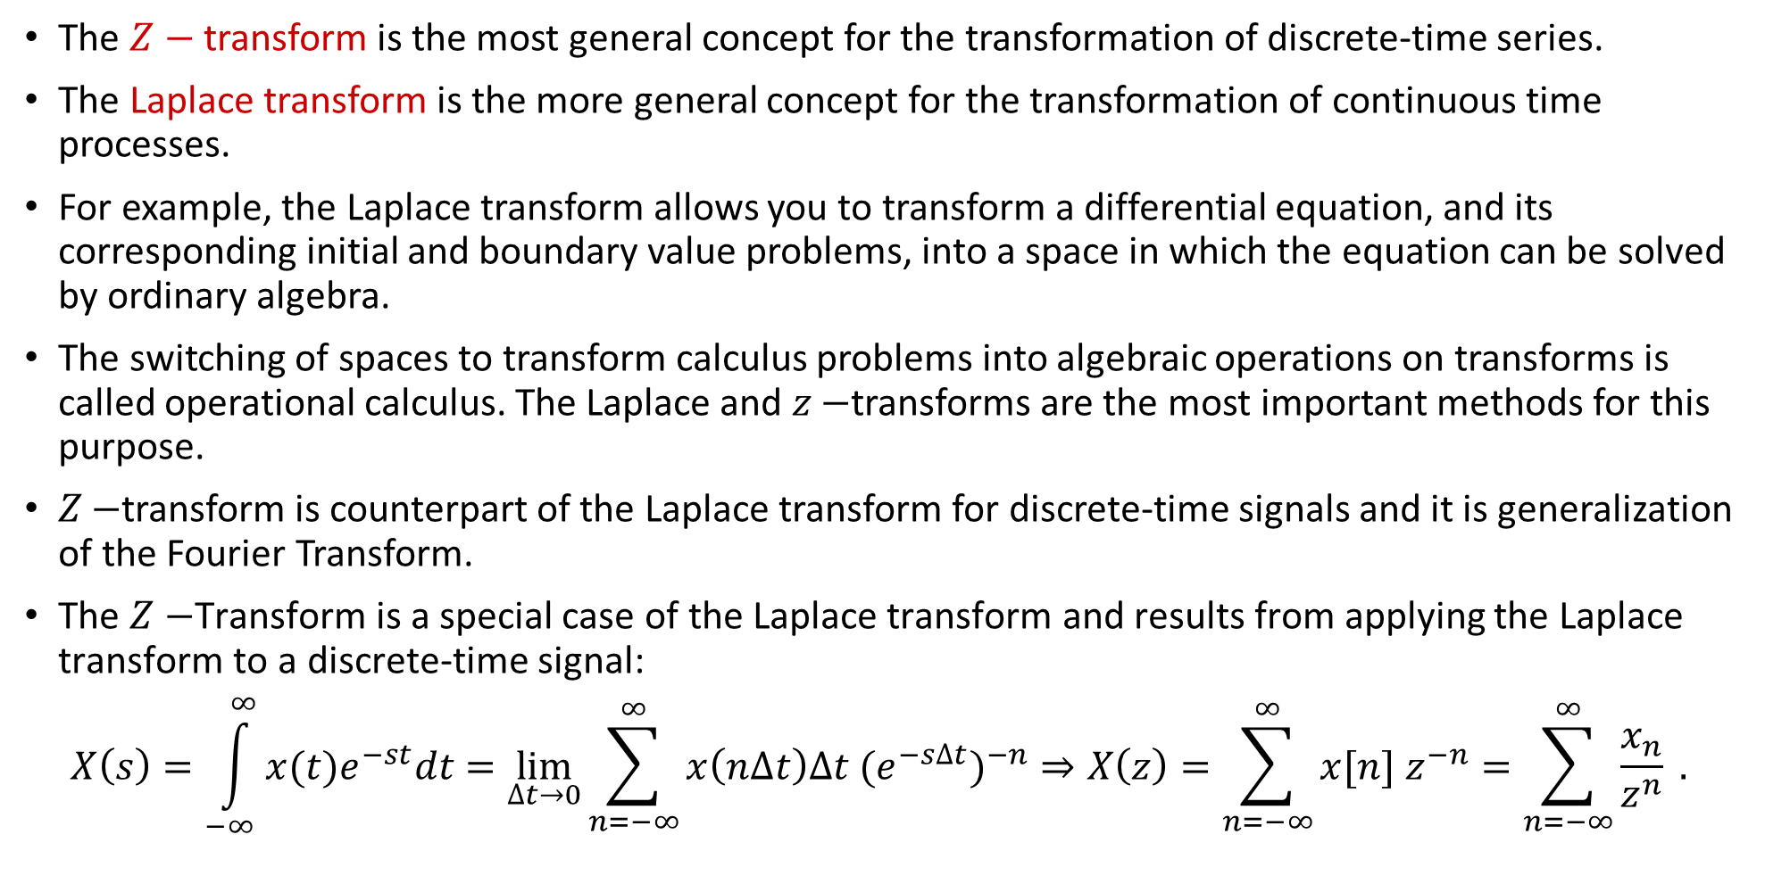




$Z−$Transform
The $Z−$transform is the most general concept for the transformation of discrete-time series.
The Laplace transform is the more general concept for the transformation of continuous time processes.
For example, the Laplace transform allows you to transform a differential equation, and its corresponding initial and boundary value problems, into a space in which the equation can be solved by ordinary algebra.
The switching of spaces to transform calculus problems into algebraic operations on transforms is called operational calculus. The Laplace and $z−$transforms are the most important methods for this purpose.
$Z−$transform is counterpart of the Laplace transform for discrete-time signals and it is generalization of the Fourier Transform.
The $Z−$Transform is a special case of the Laplace transform and results from applying the Laplace transform to a discrete-time signal:
$$X\left(s\right)=\int_{−∞}^{∞}{x(t)e^{−st}dt}=\lim_{∆t→0}{\sum_{n=−∞}^{∞}{x\left(n∆t\right)∆t {(e^{−s∆t})}^{−n}}}⇒X\left(z\right)=\sum_{n=−∞}^{∞}{x[n] z^{−n}}=\sum_{n=−∞}^{∞}{\frac{x_{n}}{z^{n}} .}$$
$$t=n∆t$$
$$x[n]$$
$$z$$

Slide 30
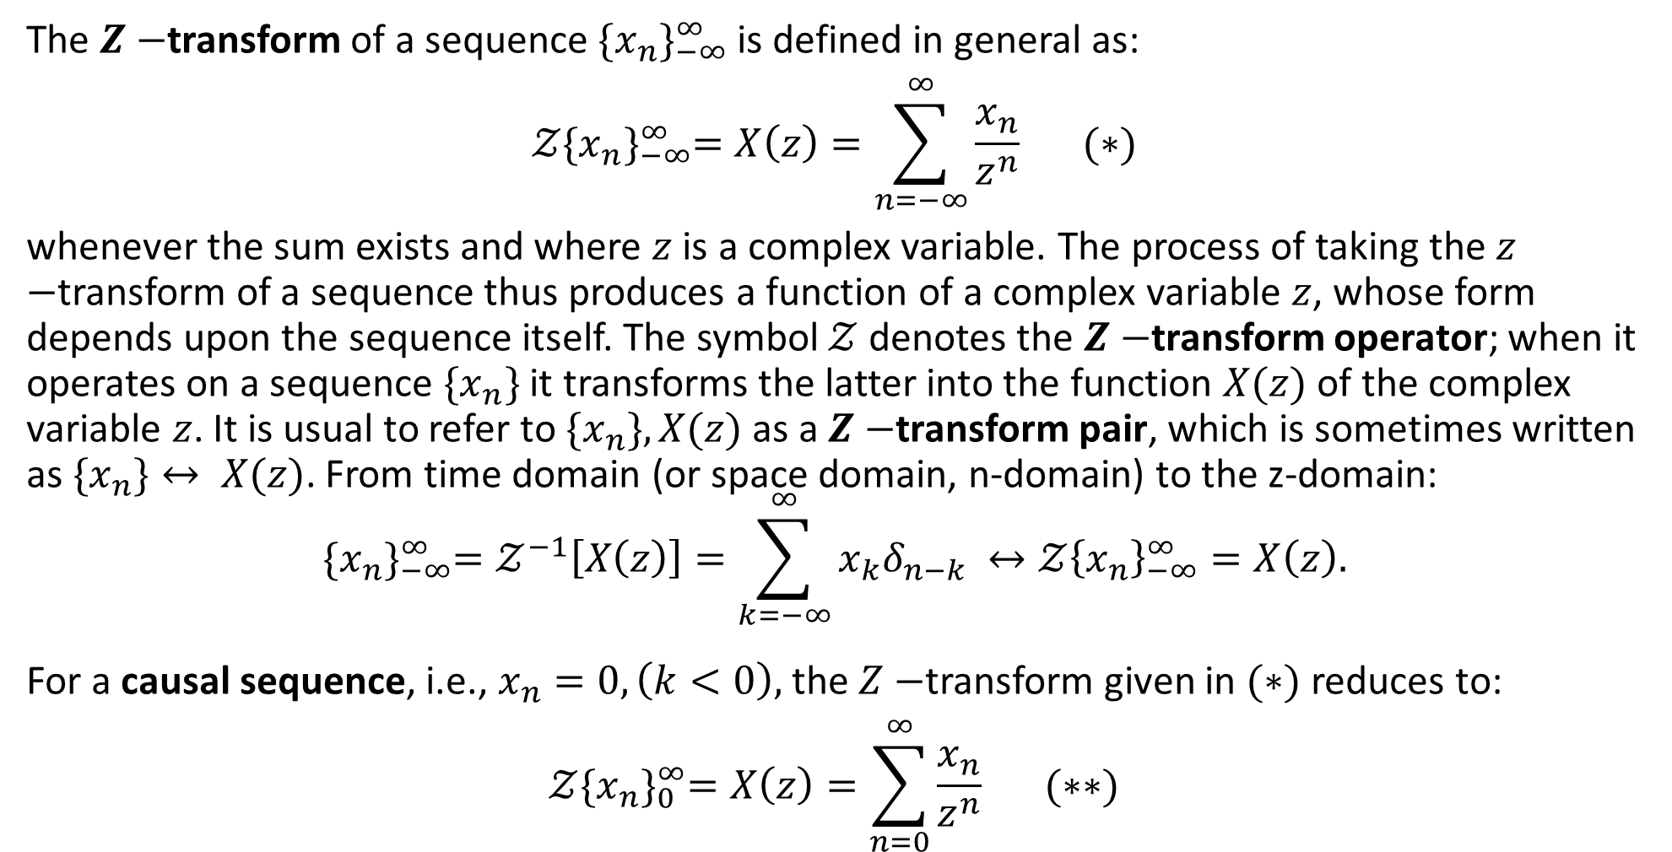

$Z−$Transform: Definition and notation
The $Z−$transform of a sequence ${\{x_{n}\}}_{−∞}^{∞}$ is defined in general as:
$$𝒵{\{x_{n}\}}_{−∞}^{∞}=X\left(z\right)=\sum_{n=−∞}^{∞}{\frac{x_{n}}{z^{n}} } (∗)$$
whenever the sum exists and where $z$ is a complex variable. The process of taking the $z−$transform of a sequence thus produces a function of a complex variable $z$, whose form depends upon the sequence itself. The symbol $𝒵$ denotes the $Z−$transform operator; when it operates on a sequence $\{x_{n}\}$ it transforms the latter into the function $X(z)$ of the complex variable $z$. It is usual to refer to $\{x_{n}\}, X(z)$ as a $Z−$transform pair, which is sometimes written as $\{x_{n}\}↔ X(z)$. From time domain (or space domain, n-domain) to the z-domain:
$${\{x_{n}\}}_{−∞}^{∞}=𝒵^{−1}\left[X\left(z\right)\right]=\sum_{k=−∞}^{∞}{x_{k}δ_{n−k} }↔𝒵{\left\{x_{n}\right\}}_{−∞}^{∞}=X\left(z\right).$$
For a causal sequence, i.e., $x_{n}=0,\left(k<0\right),$ the $Z−$transform given in $(∗)$ reduces to:
$$𝒵{\{x_{n}\}}_{0}^{∞}=X\left(z\right)=\sum_{n=0}^{∞}{\frac{x_{n}}{z^{n}} } (∗∗)$$

Slide 31
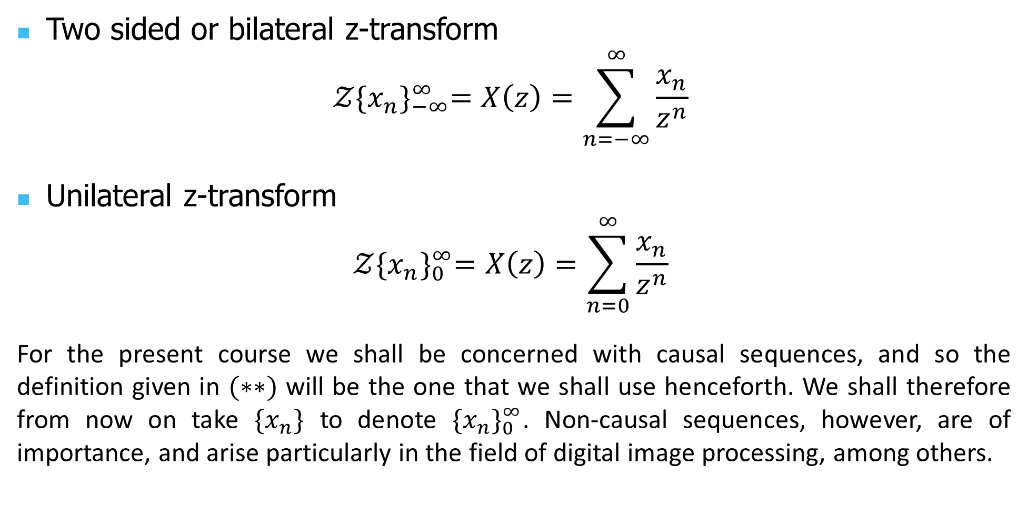
Bilateral vs. Unilateral
Two sided or bilateral z-transform
$$𝒵{\{x_{n}\}}_{−∞}^{∞}=X\left(z\right)=\sum_{n=−∞}^{∞}{\frac{x_{n}}{z^{n}} }$$
Unilateral z-transform
$$𝒵{\{x_{n}\}}_{0}^{∞}=X\left(z\right)=\sum_{n=0}^{∞}{\frac{x_{n}}{z^{n}} }$$
For the present course we shall be concerned with causal sequences, and so the definition given in $(∗∗)$ will be the one that we shall use henceforth. We shall therefore from now on take $\{x_{n}\}$ to denote ${\{x_{n}\}}_{0}^{∞}$. Non-causal sequences, however, are of importance, and arise particularly in the field of digital image processing, among others.

Slide 45
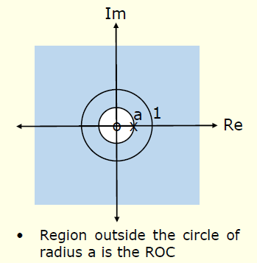
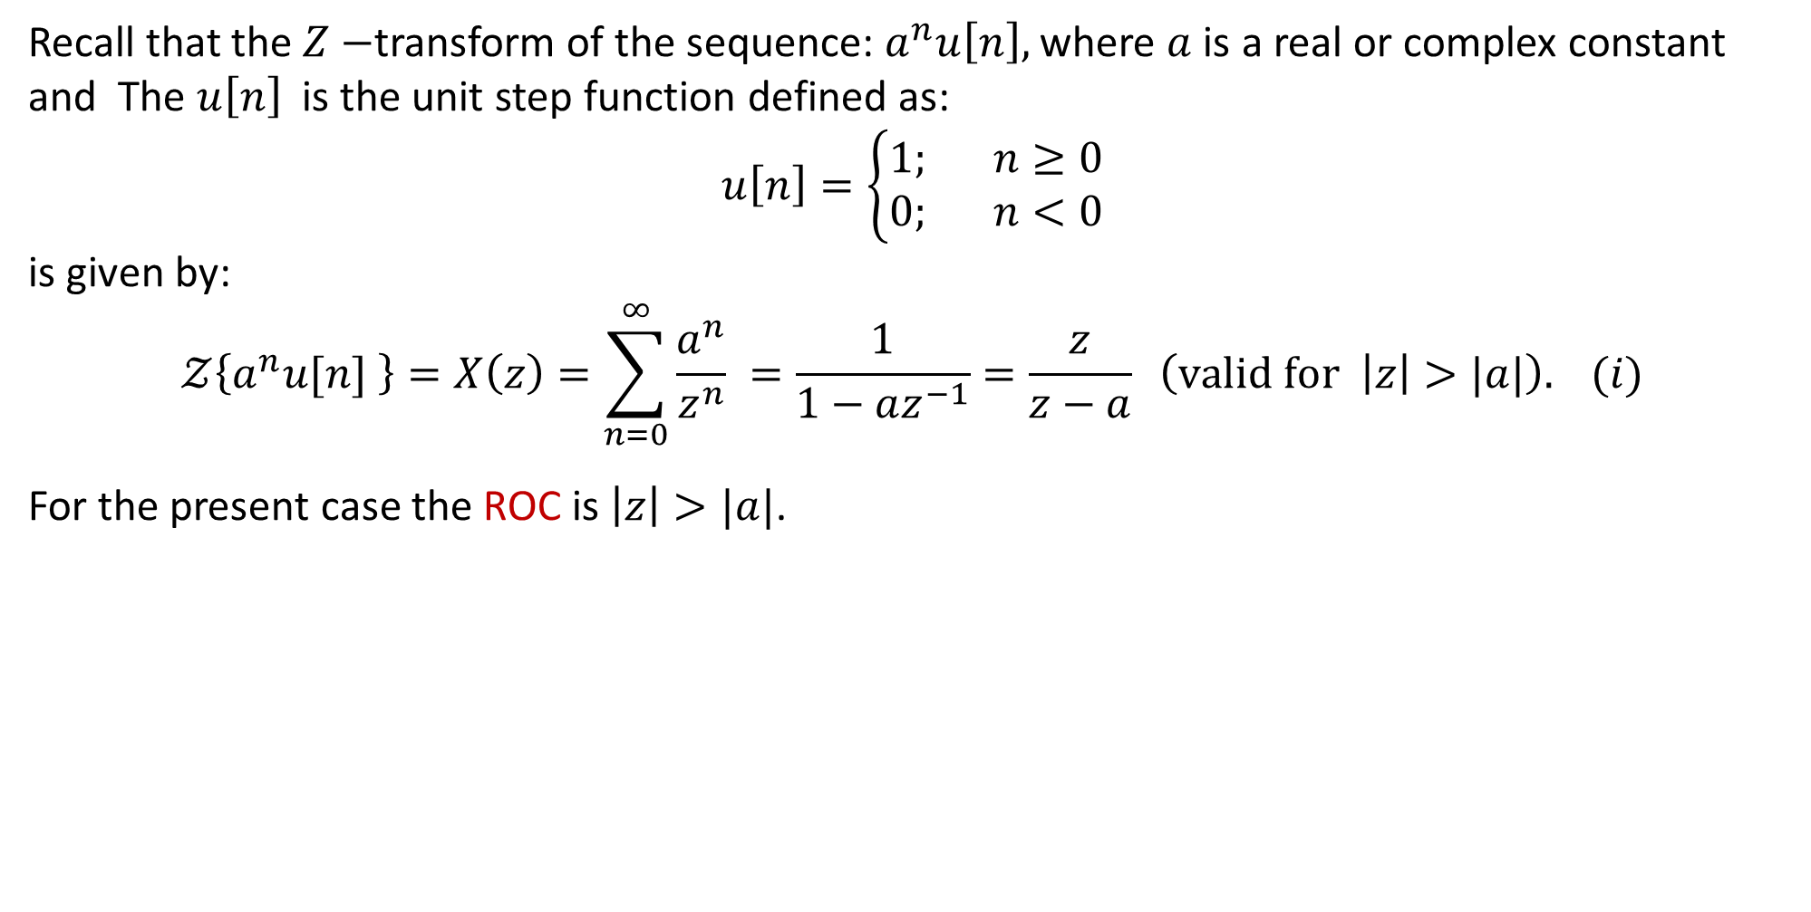
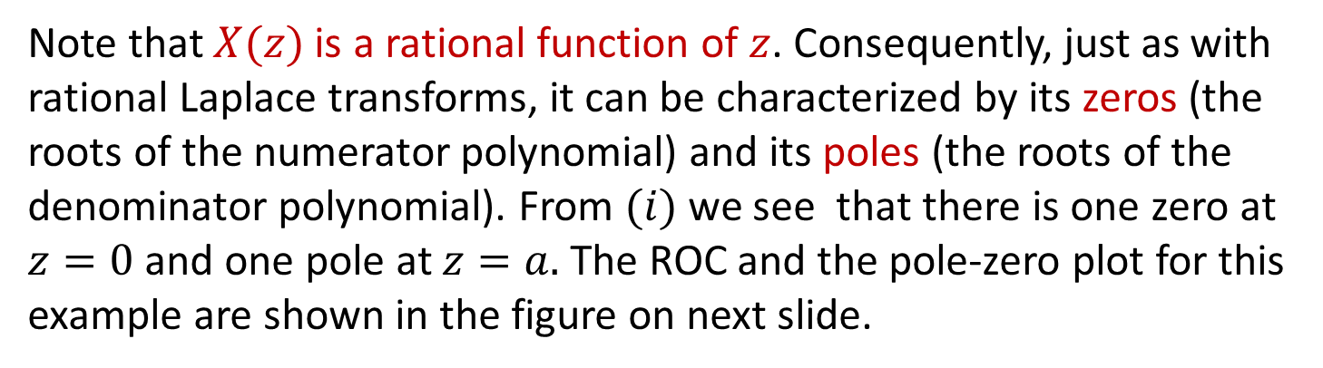
Example:
Recall that the $Z−$transform of the sequence: $a^{n}u\left[n\right],$ where $a$ is a real or complex constant and The $u\left[n\right]$ is the unit step function defined as:
$$u\left[n\right]=\left\{\begin{aligned}1; n≥0 \\ 0; n<0\end{aligned}\right.$$
is given by:
$$𝒵\left\{a^{n}u[n] \right\}=X\left(z\right)=\sum_{n=0}^{∞}{\frac{a^{n}}{z^{n}} }=\frac{1}{1−az^{−1}}=\frac{z}{z−a} \left(valid for \left|z\right|>|a|\right). (i)$$
For the present case the ROC is $\left|z\right|>|a|$.
Note that $X(z)$ is a rational function of $z$. Consequently, just as with rational Laplace transforms, it can be characterized by its zeros (the roots of the numerator polynomial) and its poles (the roots of the denominator polynomial). From $(i)$ we see that there is one zero at $z=0$ and one pole at $z=a.$ The ROC and the pole-zero plot for this example are shown in the figure on next slide.

Slide 46
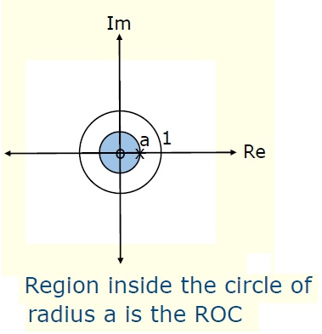
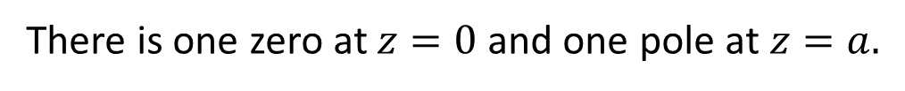
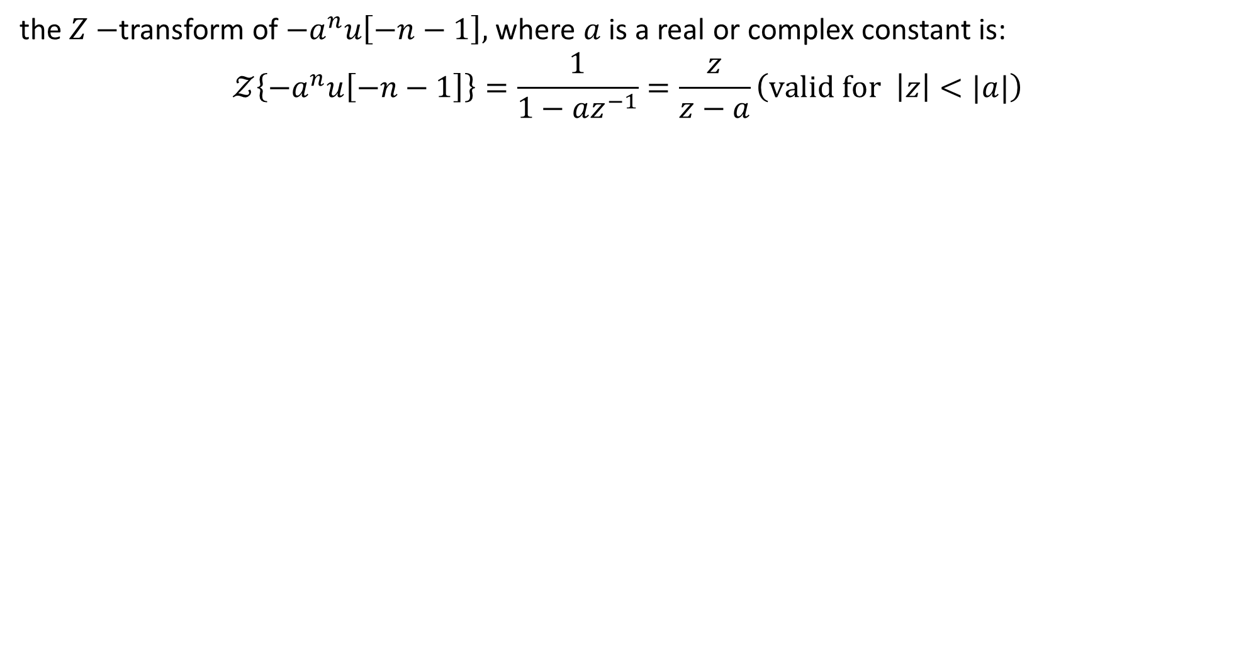
Example:
the $Z−$transform of $−a^{n}u\left[−n−1\right],$ where $a$ is a real or complex constant is:
$$𝒵\left\{{−a}^{n}u\left[−n−1\right]\right\}=\frac{1}{1−az^{−1}}=\frac{z}{z−a}\left(valid for \left|z\right|<|a|\right)$$
There is one zero at $z=0$ and one pole at $z=a.$

Slide 47
Example:
Determine the $z−$transform of the sequence:
$$\left\{x_{n}\right\}=\left\{2^{n}\right\}, (n≥0)$$
Solution: Using $\left(∗∗\right)$ we have:
$$𝒵\left\{2^{n}\right\}=X\left(z\right)=\sum_{n=0}^{∞}{\frac{2^{n}}{z^{n}} },$$
which we recognize as a geometric series, with common ratio $r=2/z$ between successive terms. Thus the series converges for $|z|>2,$ when
$$\sum_{n=0}^{∞}{{\left(\frac{2}{z}\right)}^{n}}=\lim_{n→∞}{\frac{1−{(2/z)}^{n}}{1−2/z}=\frac{1}{1−2/z}},$$
leading to
$$𝒵\left\{2^{n}\right\}=X\left(z\right)=\sum_{n=0}^{∞}{\frac{2^{n}}{z^{n}} }=\frac{z}{z−2} \left(\left|z\right|>2\right) (i)$$
so that $\left\{2^{n}\right\}↔\frac{z}{z−2},$ represents a $Z−$transform pair. Here $|z|>2$ is the region of convergence (ROC)

Slide 48
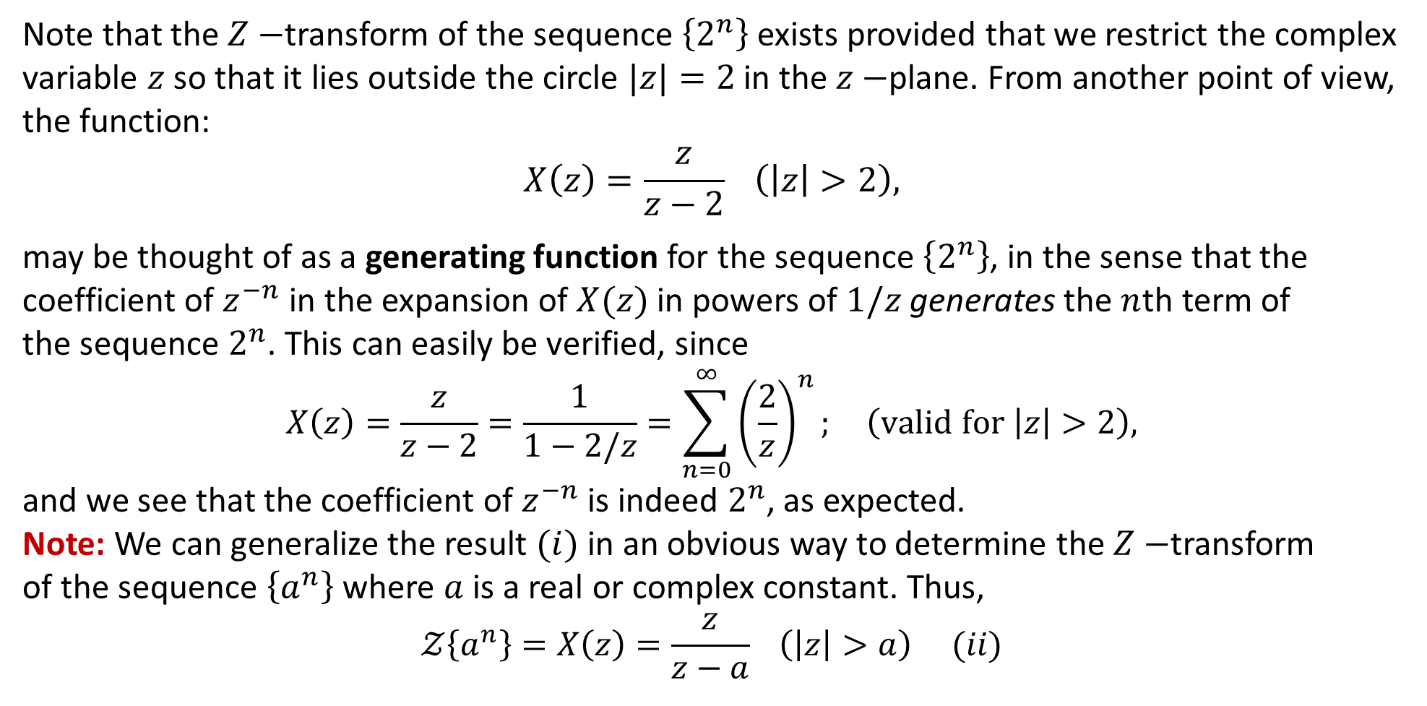
Example:
Note that the $Z−$transform of the sequence $\left\{2^{n}\right\}$ exists provided that we restrict the complex variable $z$ so that it lies outside the circle $|z|=2$ in the $z−$plane. From another point of view, the function:
$$X\left(z\right)=\frac{z}{z−2} \left(\left|z\right|>2\right),$$
may be thought of as a generating function for the sequence $\left\{2^{n}\right\}$, in the sense that the
coefficient of $z^{−n}$ in the expansion of $X(z)$ in powers of $1/z$ generates the $n$th term of
the sequence $2^{n}$. This can easily be verified, since
$$X\left(z\right)=\frac{z}{z−2}=\frac{1}{1−2/z}=\sum_{n=0}^{∞}{{\left(\frac{2}{z}\right)}^{n};} \left(valid for \left|z\right|>2\right),$$
and we see that the coefficient of $z^{−n}$ is indeed $2^{n}$, as expected.
Note: We can generalize the result $(i)$ in an obvious way to determine the $Z−$transform
of the sequence $\left\{a^{n}\right\}$where $a$ is a real or complex constant. Thus,
$$𝒵\left\{a^{n}\right\}=X\left(z\right)=\frac{z}{z−a} \left(\left|z\right|>a\right) (ii)$$

Slide 49
Example:
Show that:
$𝒵\left\{{\left(\frac{−1}{2}\right)}^{n}\right\}=\frac{2z}{2z+1} \left(\left|z\right|>\frac{1}{2}\right).$
Solution: Using $\left(ii\right)$ we have:
$$𝒵\left\{a^{n}\right\}=X\left(z\right)=\frac{z}{z−a} \left(\left|z\right|>a\right) .$$
Taking $a=−\frac{1}{2},$ we get:
$$𝒵\left\{{\left(\frac{−1}{2}\right)}^{n}\right\}=X\left(z\right)=\frac{z}{z−(−1/2)}=\frac{2z}{2z+1} \left(valid for \left|z\right|>\frac{1}{2}\right)$$
so that: $\left\{{\left(\frac{−1}{2}\right)}^{n}\right\}↔\frac{2z}{2z+1},$ represents a $Z−$transform pair, with $\left|z\right|>\frac{1}{2}$ is the region of convergence (ROC)

Slide 50
Example:
Determine the $z−$transform of the sequence: $\left\{x_{n}\right\}=\left\{n\right\}, (n≥0)$
Solution: Using $\left(ii\right)$ we have:
$$𝒵\left\{a^{n}\right\}=X\left(z\right)=\frac{z}{z−a} \left(\left|z\right|>a\right) .$$
Differentiating both sides of above equation with respect to $a$, which for the moment we regard as a parameter, we get:
$$\frac{d}{da}𝒵\left\{a^{n}\right\}=𝒵\left\{\frac{da^{n}}{da}\right\}=\frac{d}{da}\left(\frac{z}{z−a}\right),$$
leading to
$$𝒵\left\{{na}^{n−1}\right\}=\frac{z}{{(z−a)}^{2}} \left(\left|z\right|>a\right).$$
In particular for $a=1,$ the last equation takes the form:
$$𝒵\left\{n\right\}=\frac{z}{{(z−1)}^{2}} \left(\left|z\right|>1\right).$$

Slide 51
Example:
Determine the $z−$transform of the sequence: $\left\{2n\right\}=\left\{0,2,4,6,…\right\}.$
Solution: We know that
$$𝒵\left\{n\right\}=𝒵\left\{0,1,2,3,…\right\}=\sum_{n=0}^{∞}{\frac{n}{z^{n}} }=\frac{z}{{(z−1)}^{2}} \left(\left|z\right|>1\right).$$
Now
$$𝒵\left\{2n\right\}=𝒵\left\{0,2,4,6,…\right\}=\sum_{n=0}^{∞}{\frac{2n}{z^{n}} }=2\sum_{n=0}^{∞}{\frac{n}{z^{n}} }=2𝒵\left\{n\right\}.$$
Thus,
$$𝒵\left\{2n\right\}=\frac{2z}{{(z−1)}^{2}} \left(\left|z\right|>1\right).$$

Slide 52
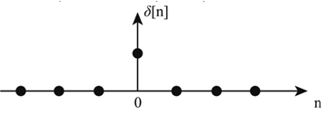
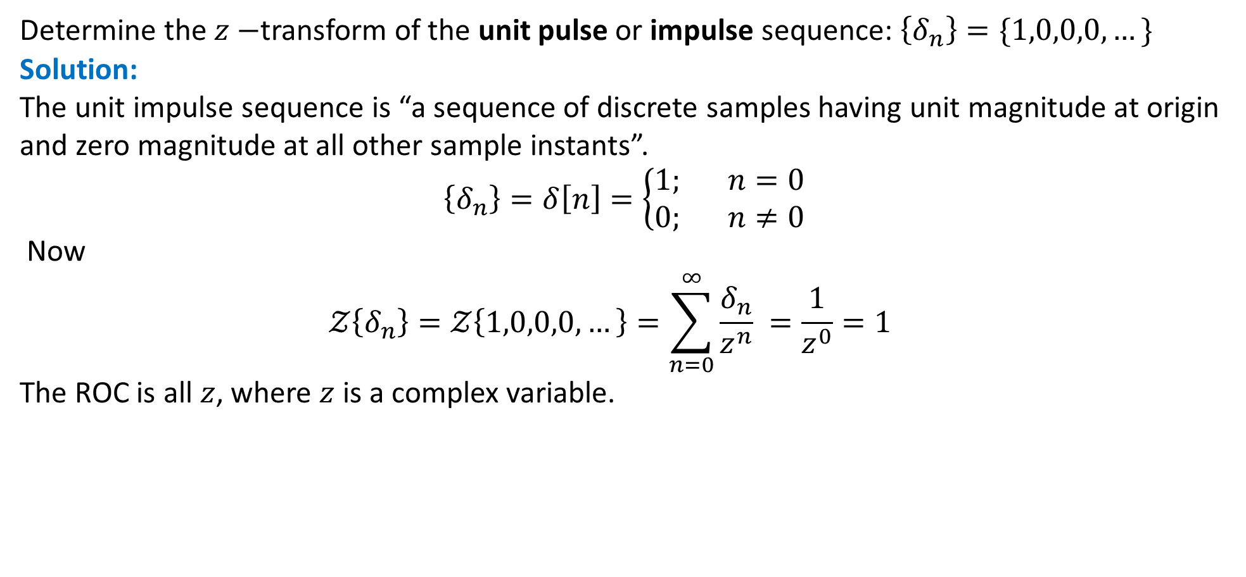
Example: unit pulse or impulse sequence
Determine the $z−$transform of the unit pulse or impulse sequence: $\left\{δ_{n}\right\}=\{1,0,0,0,…\}$
Solution:
The unit impulse sequence is “a sequence of discrete samples having unit magnitude at origin and zero magnitude at all other sample instants”.
$$\left\{δ_{n}\right\}=δ\left[n\right]=\left\{\begin{aligned}1; n=0 \\ 0; n≠0\end{aligned}\right.$$
Now
$$𝒵\left\{δ_{n}\right\}=𝒵\left\{1,0,0,0,…\right\}=\sum_{n=0}^{∞}{\frac{δ_{n}}{z^{n}} }=\frac{1}{z^{0}}=1$$
The ROC is all $z$, where $z$ is a complex variable.

Slide 53
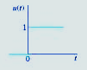
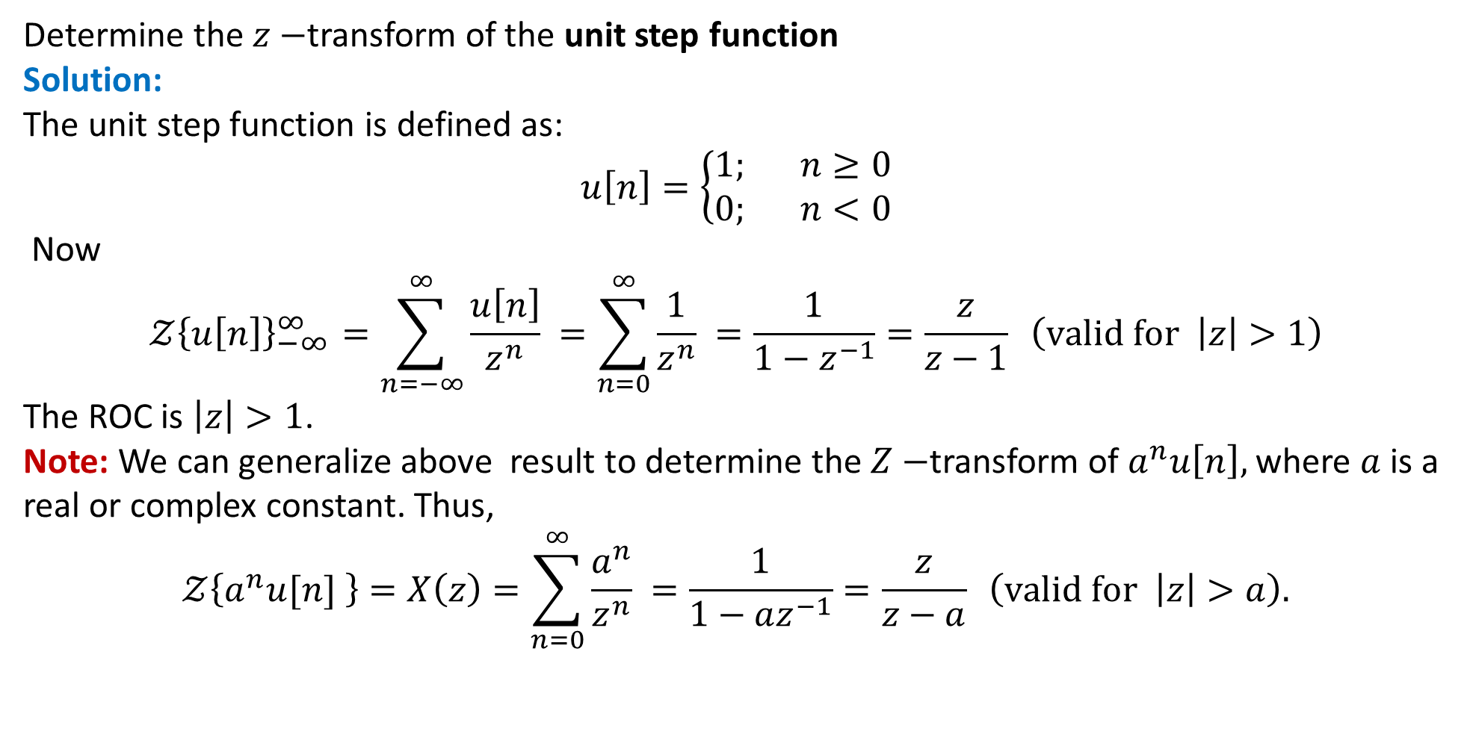
Example: unit step function
Determine the $z−$transform of the unit step function
Solution:
The unit step function is defined as:
$$u\left[n\right]=\left\{\begin{aligned}1; n≥0 \\ 0; n<0\end{aligned}\right.$$
Now
$$𝒵{\left\{u\left[n\right]\right\}}_{−∞}^{∞}=\sum_{n=−∞}^{∞}{\frac{u\left[n\right]}{z^{n}} }=\sum_{n=0}^{∞}{\frac{1}{z^{n}} }=\frac{1}{1−z^{−1}}=\frac{z}{z−1} \left(valid for \left|z\right|>1\right)$$
The ROC is $\left|z\right|>1$.
Note: We can generalize above result to determine the $Z−$transform of $a^{n}u\left[n\right],$ where $a$ is a real or complex constant. Thus,
$$𝒵\left\{a^{n}u[n] \right\}=X\left(z\right)=\sum_{n=0}^{∞}{\frac{a^{n}}{z^{n}} }=\frac{1}{1−az^{−1}}=\frac{z}{z−a} \left(valid for \left|z\right|>a\right).$$

Slide 54
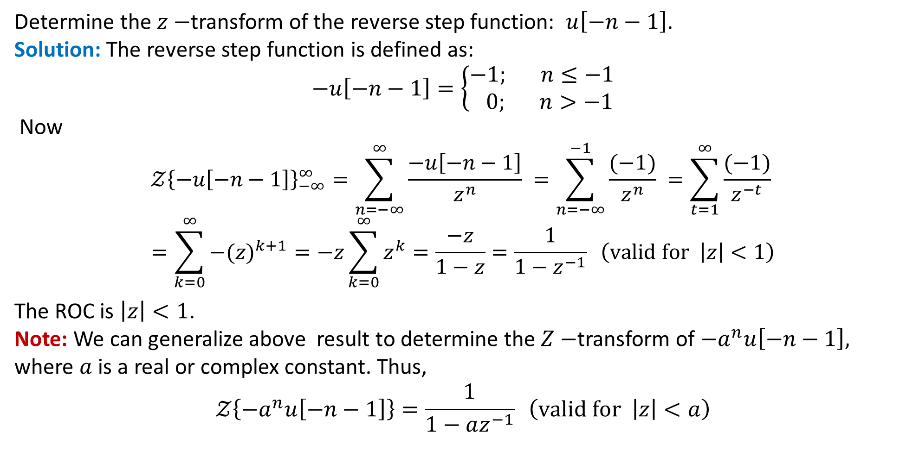
Example: reverse step function
Determine the $z−$transform of the reverse step function: $u\left[−n−1\right]$.
Solution: The reverse step function is defined as:
$$−u\left[−n−1\right]=\left\{\begin{aligned}−1; n≤−1 \\ 0; n>−1\end{aligned}\right.$$
Now
$$𝒵{\left\{−u\left[−n−1\right]\right\}}_{−∞}^{∞}=\sum_{n=−∞}^{∞}{\frac{−u\left[−n−1\right]}{z^{n}} }=\sum_{n=−∞}^{−1}{\frac{(−1)}{z^{n}} }=\sum_{t=1}^{∞}{\frac{(−1)}{z^{−t}} }$$
$$=\sum_{k=0}^{∞}{{−(z)}^{k+1}}=−z\sum_{k=0}^{∞}{z^{k}}=\frac{−z}{1−z}=\frac{1}{1−z^{−1}} \left(valid for \left|z\right|<1\right)$$
The ROC is $\left|z\right|<1$.
Note: We can generalize above result to determine the $Z−$transform of $−a^{n}u\left[−n−1\right],$ where $a$ is a real or complex constant. Thus,
$$𝒵\left\{{−a}^{n}u\left[−n−1\right]\right\}=\frac{1}{1−az^{−1}} \left(valid for \left|z\right|<a\right)$$

Slide 64
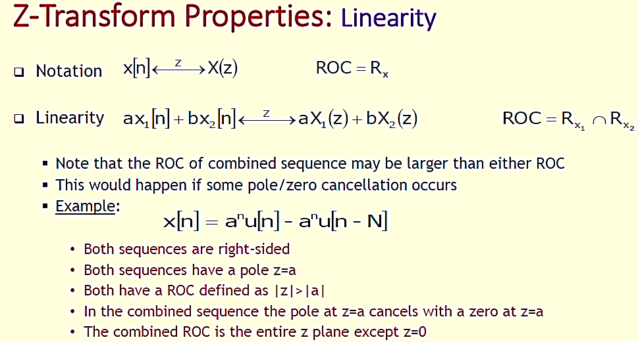

Slide 65
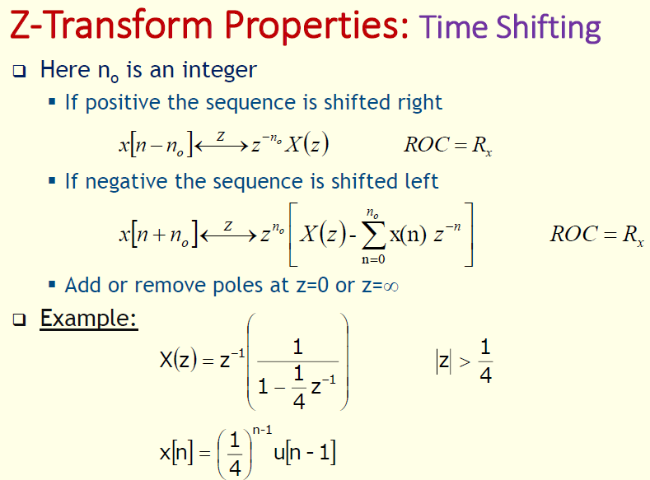

Slide 66
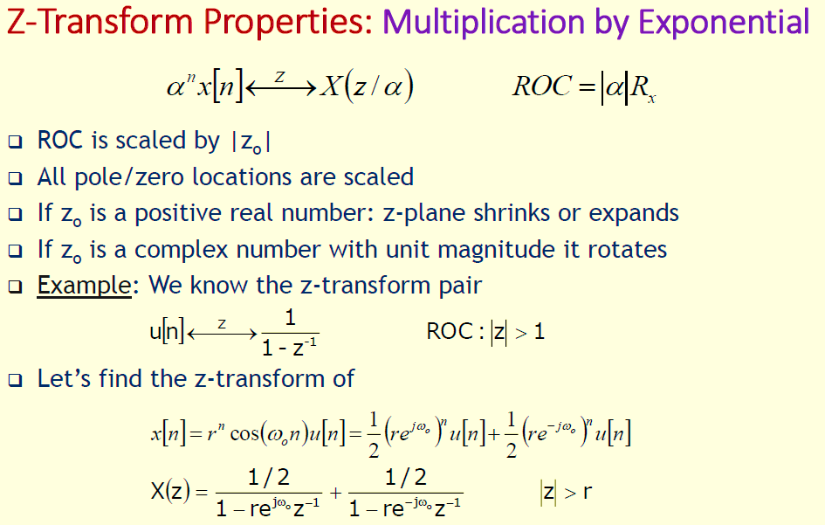

Slide 68
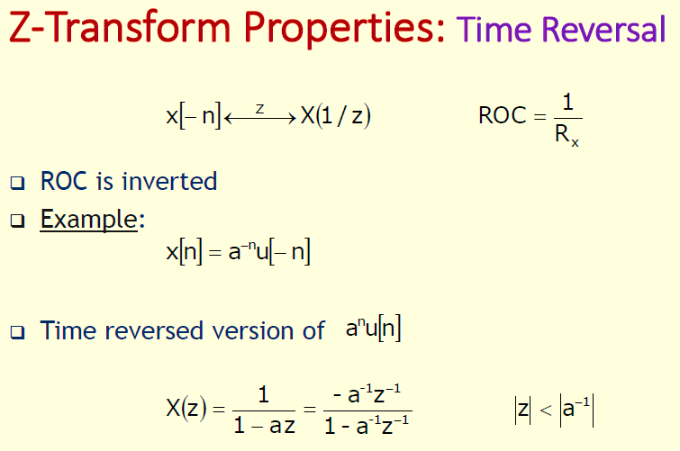

Slide 70
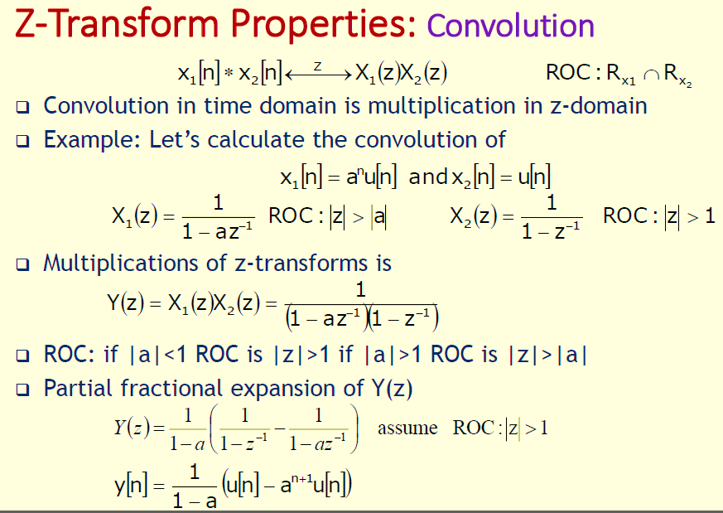

Slide 71
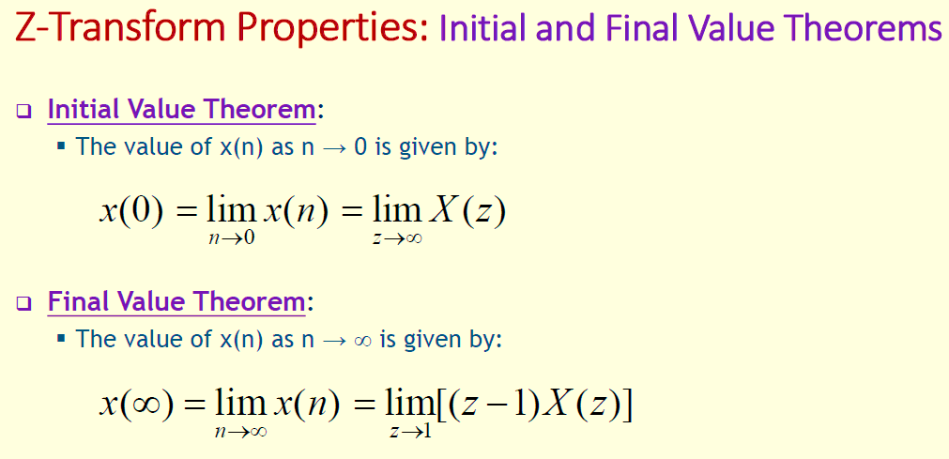

Slide 72
Example: The continuous-time function $f\left(t\right)=cos ωt u(t),$ where $ω$ is a constant and $u(t)$ is unit step function, is sampled in the idealized sense at intervals $T$ to generate the sequence $\{cos⁡nωT\}.$ Determine the $Z−$ transform of the sequence.
Solution: Using the result $\cos{nωT}=\frac{e^{inωT}+e^{−inωT}}{2}$ and the linearity property, we have:
$$𝒵\left\{\cos{nωT}\right\}=\frac{1}{2}\left[𝒵\left\{e^{inωT}\right\}+𝒵\left\{e^{inωT}\right\}\right].$$
We know that:
$$𝒵\left\{a^{n}\right\}=\frac{z}{z−a}; \left(valid for \left|z\right|>\left|a\right|\right).$$
Thus,
$$𝒵\left\{{{(e}^{iωT})}^{n}\right\}=\frac{z}{z−e^{iωT}}; \left(valid for \left|z\right|>\left|e^{iωT}\right|⇒\left|z\right|>1\right).$$
and
$$𝒵\left\{{{(e}^{−iωT})}^{n}\right\}=\frac{z}{z−e^{−iωT}}; \left(valid for \left|z\right|>\left|e^{−iωT}\right|⇒\left|z\right|>1\right).$$
Therefore,
$𝒵\left\{\cos{nωT}\right\}=\frac{1}{2}\left[\frac{z}{z−e^{iωT}}+\frac{z}{z−e^{−iωT}}\right]=\frac{z(z−\cos{ωT})}{z^{2}−2z\cos{ωT}+1} \left(valid for \left|z\right|>1\right).$

Slide 73
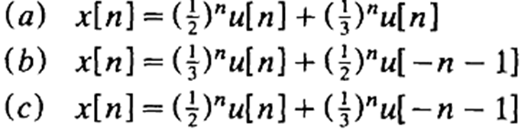
Example: Find the $Z−$transform and sketch the pole-zero plot with the ROC for each of the following sequences:
Solution: $(b)$ We know that:
$$𝒵\left\{a^{n}u[n] \right\}=\frac{z}{z−a} \left(valid for \left|z\right|>|a|\right) (i)$$
and
$$𝒵\left\{{−b}^{n}u\left[−n−1\right]\right\}=\frac{z}{z−b} \left(valid for \left|z\right|<|b|\right) (ii)$$
Thus, by using linearity property and eqs. $(i)$ and $(ii)$, with $a=1/3$ and $b=1/2,$ we have:
$$𝒵\left\{x[n] \right\}=X(z)=𝒵\left\{{\left(1/3\right)}^{n}u[n] \right\}+𝒵\left\{{\left(1/2\right)}^{n}u\left[−n−1\right]\right\}$$
$$=\frac{z}{z−1/3}−\frac{z}{z−1/2}=\frac{−1}{6}\frac{z}{(z−1/2)(z−1/3)}\left(valid for \frac{1}{3}<\left|z\right|<\frac{1}{2}\right)$$
For the present case $X(z)$ has one zero at $z=0$ and two poles at $z=1/2$ and $z=1/3$ and that the ROC is: $\frac{1}{3}<\left|z\right|<\frac{1}{2}.$

Slide 74
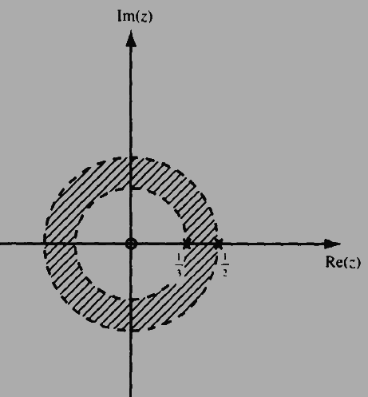
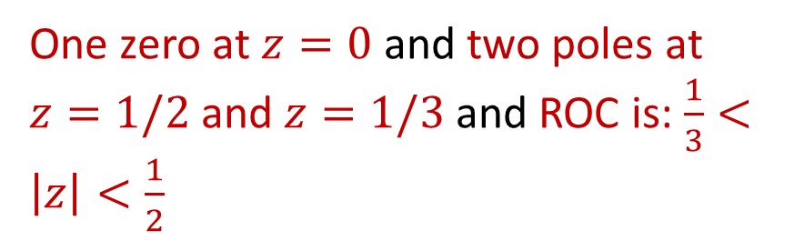
One zero at $z=0$ and two poles at $z=1/2$ and $z=1/3$ and ROC is: $\frac{1}{3}<\left|z\right|<\frac{1}{2}$

Slide 75
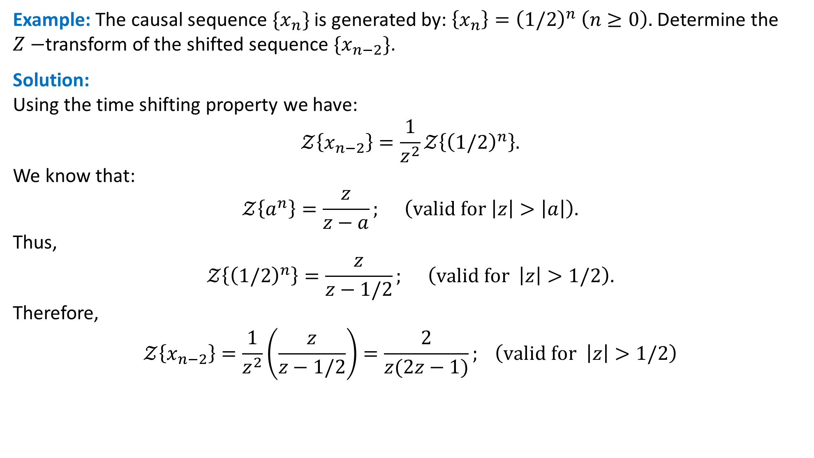
Example: The causal sequence $\{x_{n}\}$ is generated by: $\left\{x_{n}\right\}={\left(1/2\right)}^{n} \left(n≥0\right).$ Determine the $Z−$transform of the shifted sequence $\{x_{n−2}\}$.
Solution:
Using the time shifting property we have:
$$𝒵\left\{x_{n−2}\right\}=\frac{1}{z^{2}}𝒵\left\{{\left(1/2\right)}^{n}\right\}.$$
We know that:
$$𝒵\left\{a^{n}\right\}=\frac{z}{z−a}; \left(valid for \left|z\right|>\left|a\right|\right).$$
Thus,
$$𝒵\left\{{\left(1/2\right)}^{n}\right\}=\frac{z}{z−1/2}; \left(valid for \left|z\right|>1/2\right).$$
Therefore,
$$𝒵\left\{x_{n−2}\right\}=\frac{1}{z^{2}}\left(\frac{z}{z−1/2}\right)=\frac{2}{z(2z−1)}; \left(valid for \left|z\right|>1/2\right)$$

Slide 76
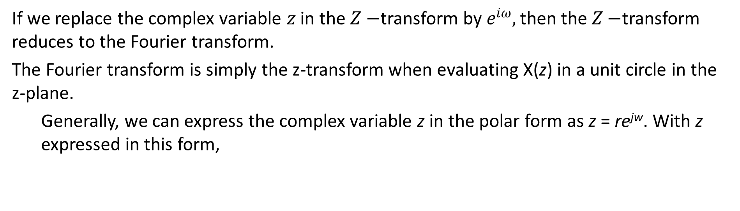
Relationship to the Fourier Transform
If we replace the complex variable $z$ in the $Z−$transform by $e^{iω},$ then the $Z−$transform reduces to the Fourier transform.
The Fourier transform is simply the z-transform when evaluating X(z) in a unit circle in the z-plane.
Generally, we can express the complex variable z in the polar form as z = re^{jw}. With z expressed in this form,

Slide 77
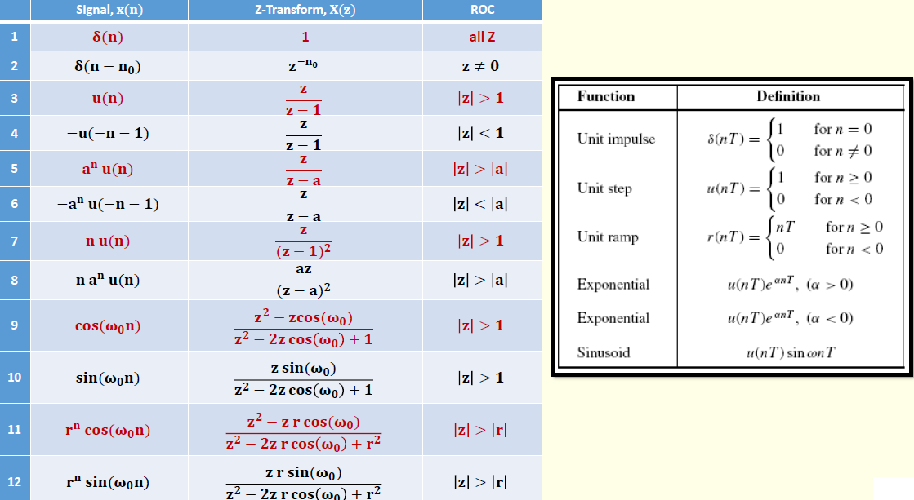

Slide 78
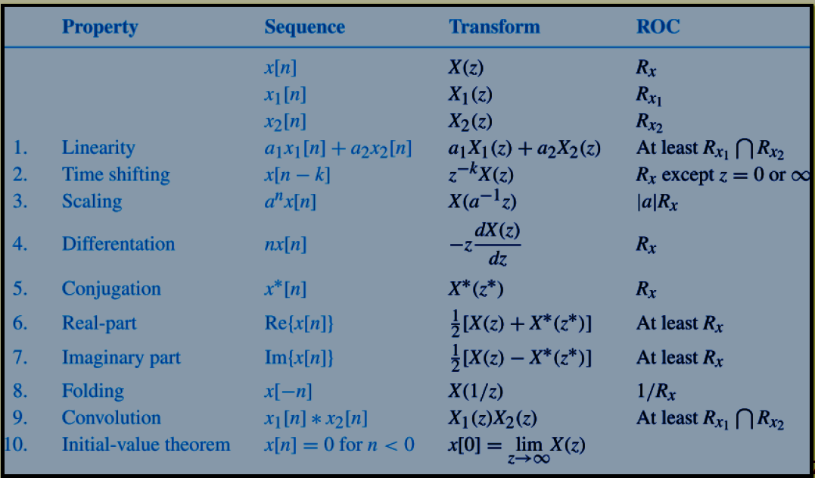
Properties of the z transform

